Slide 1
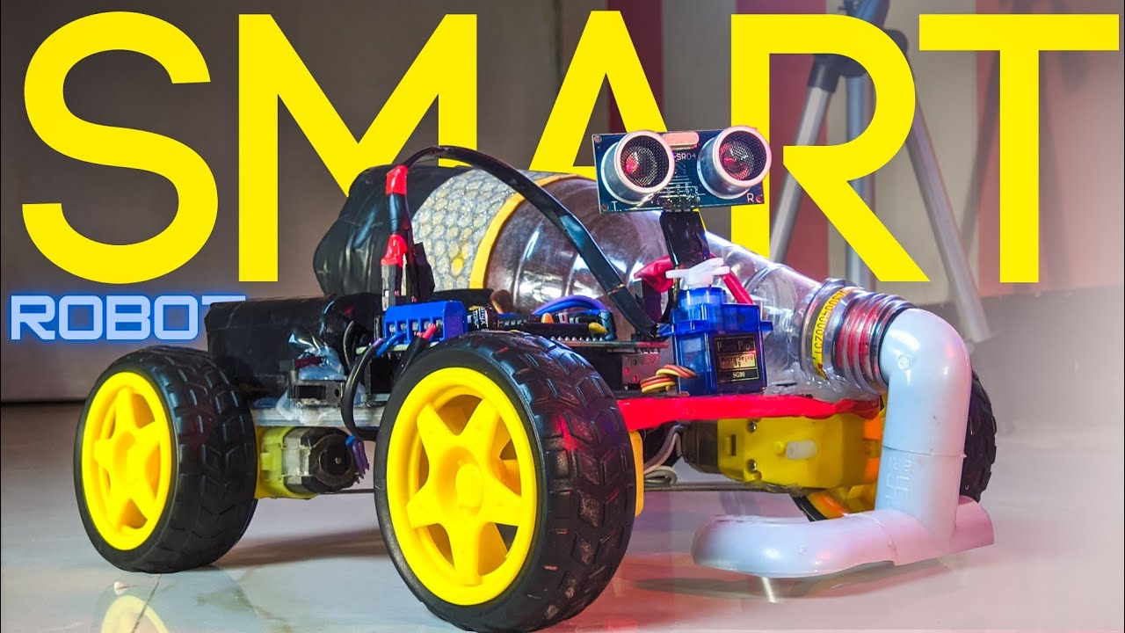
SMART VACCUM CLEANER CONTROLLED MANUALLY ANDAUTOMATICALLY
-OBJECTIVE
VACA
SMART VACCUM CLEANER

Slide 2
TEAM
MATES
TEAM TITANS
SARAN.S
MANOJJ.K
MURUGESAN.A
RAHUL.A
TIME AND KNOWLEDGE

Slide 3

COMPONENTS USED
1.ULTRASONIC SENSOR
2.BLUETOOTH MODULE HS-03
3.ARDUINO-UNOR3
4.TT GEAR MOTORS
5.3-6V DC MOTOR FOR SUCTION
6.L298N DUAL MOTOR DRIVER
YOU CAN ADD YOUR WEBSITE

Slide 4
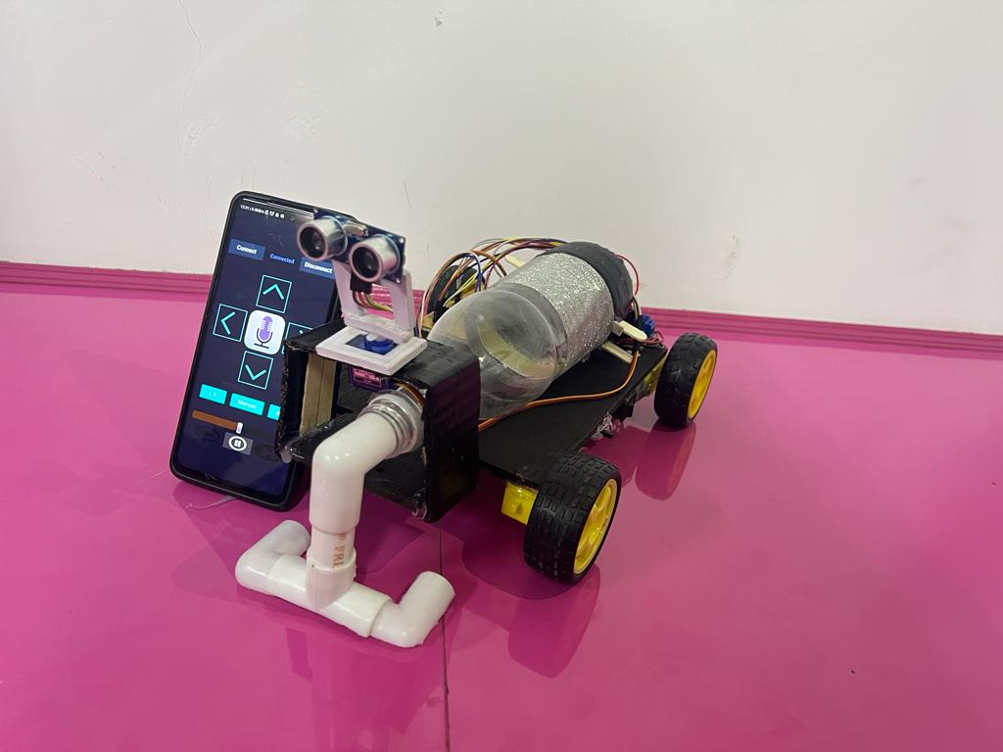
PROBLEM:
IT’S A HECK TO CLEAN MANUALLY IN OUR BUSY SCHEDULE.
A SEPARATE BUDGET IS ALLOCATED FOR CLEANING AUTOMATION.
OUR SOLUTION :
EASY TO USE.
IT’S AFFORDABLE.
CUSTOMISABLE.
MULTICONTROL ACCESS MODES

Slide 5

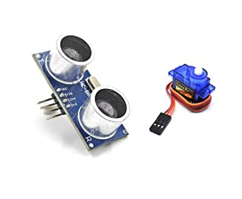
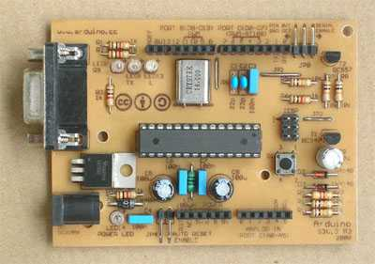
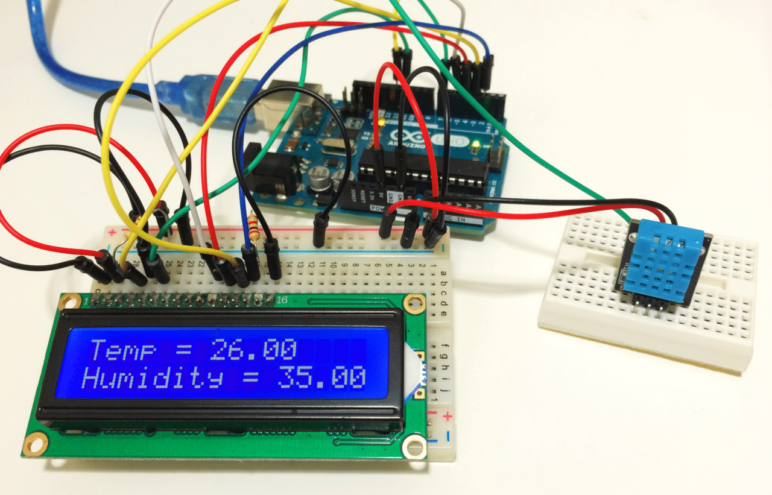
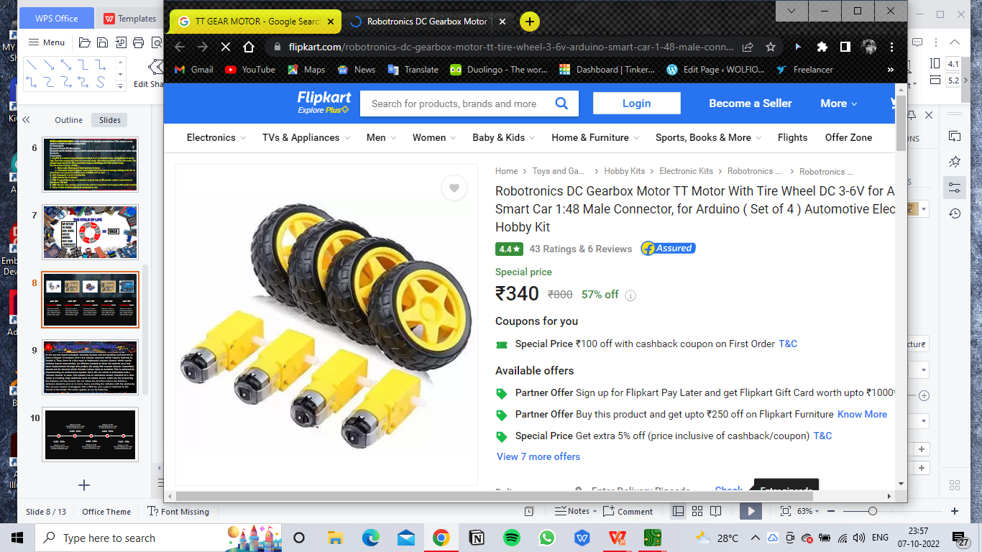
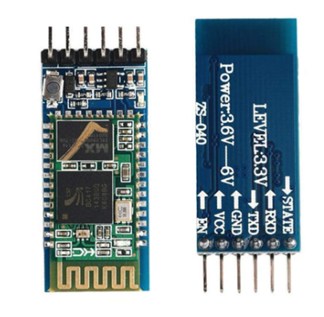
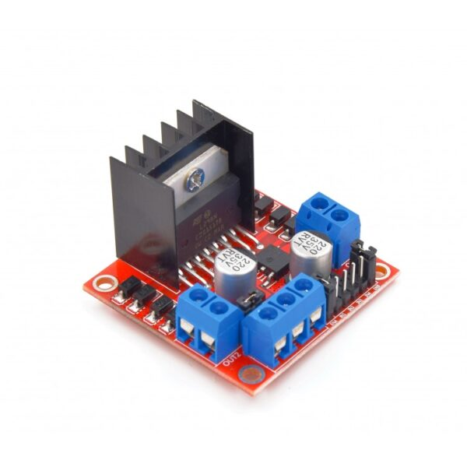
TT GEAR MOTORS & L298N MOTOR DRIVER
ULTRASONIC AND SERVO
ARDUINO PCB
DHT11 & LCD MODULE
HC-03
MOUNTING THE COMPONENTS AND GETTING THE OUTPUT
MOUNTING THE COMPONENTS AND GETTING THE OUTPUT
MOUNTING THE COMPONENTS AND GETTING THE OUTPUT
MOUNTING THE COMPONENTS AND GETTING THE OUTPUT
MOUNTING THE COMPONENTS AND GETTING THE OUTPUT

Slide 6
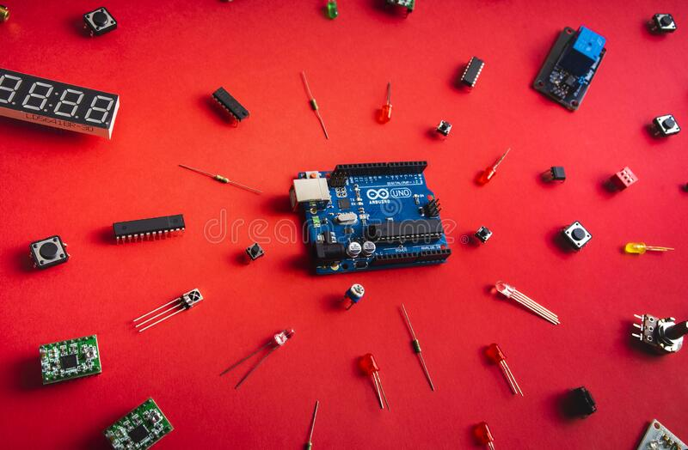
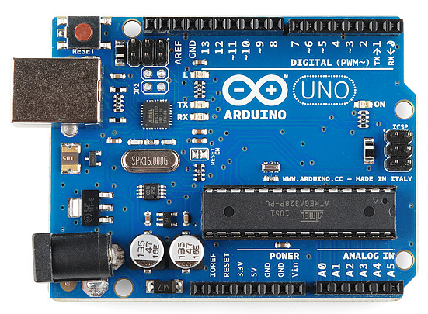
HOME MADE ARDUINO PCB
Step 1: Alter the Changes in the Original Schematic. ...
Step 2: Gather the Components Required. ...
Step 3: Draw the Final Schematic. ...
Step 4: Design the PCB and Paste it on Cu board .
Step 5: Solder the Components on the PCB. ...
Step 6: Burn the Bootloader on the Microcontroller. ...
Step 7: Program the Arduino (using FTDI Breakout Board)
Arduino is an open-source electronics platform based on easy-to-use hardware and software. Arduino boards are able to read inputs - light on a sensor, a finger on a button, or a Twitter message - and turn it into an output - activating a motor, turning on an LED, publishing something online.

Slide 7
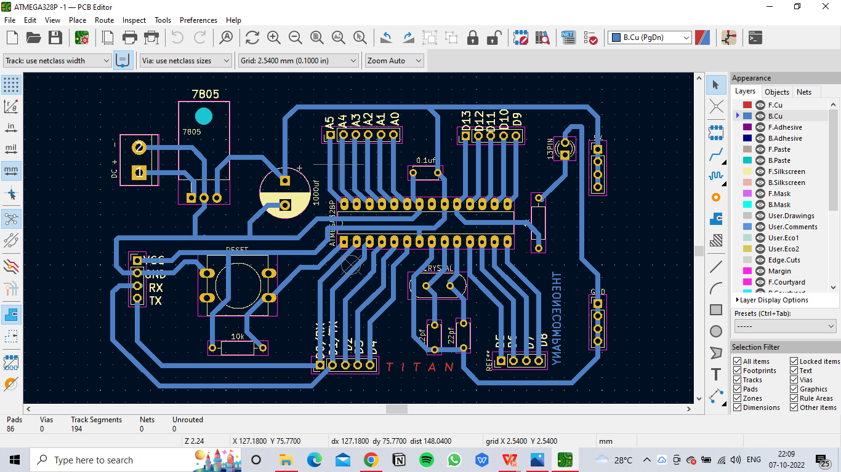
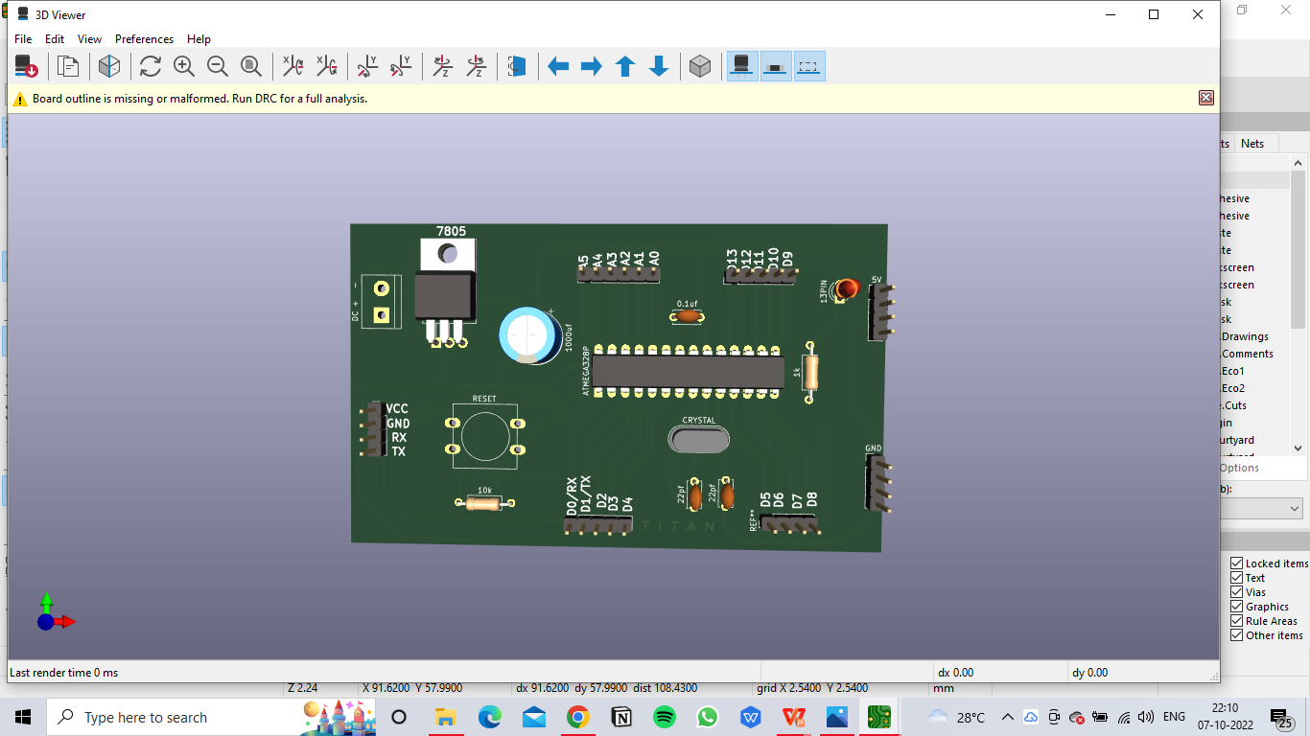
FERRIC CHLORIDE ETCHING IN CU BOARD

Slide 8
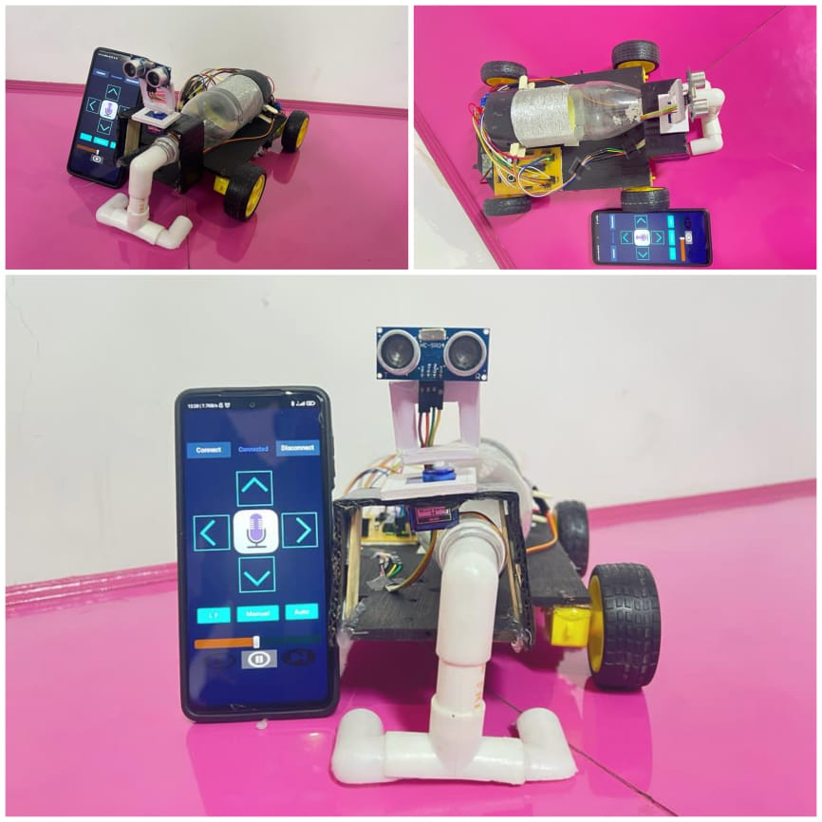

Slide 9
HC-05 is a Bluetooth module which is designed for wireless comunication. This module can be used in a master or slave configuration.
Pin Description
Bluetooth Module Pin Description
Bluetooth serial modules allow all serial enabled devices to communicate with each other using Bluetooth.
It has 6 pins,
1. Key/EN: It is used to bring Bluetooth module in AT commands mode. If Key/EN pin is set to high, then this module will work in command mode. Otherwise by default it is in data mode. The default baud rate of HC-05 in command mode is 38400bps and 9600 in data mode.
HC-05 module has two modes,
1. Data mode: Exchange of data between devices.
2. Command mode: It uses AT commands which are used to change setting of HC-05. To send these commands to module serial (USART) port is used.
2. VCC: Connect 5 V or 3.3 V to this Pin.
3. GND: Ground Pin of module.
4. TXD: Transmit Serial data (wirelessly received data by Bluetooth module transmitted out serially on TXD pin)
5. RXD: Receive data serially (received data will be transmitted wirelessly by Bluetooth module).
6. State: It tells whether module is connected or not.

Slide 10
02
WORKING
Add your words here
Add your words here
The suction motor creates vacuum pressure and suction by rotating a motor fan. The impeller rotates at high speed . A suction motor's power is measured by multiplying the rate of air flow and the vacuum pressure, which induces air flow from the brush through the hose.
A power supply is an electrical device that supplies electric power to an electrical load.
POWER SUPPLY HERE - 7-12V DC
(9V IS COMMONLY USED HERE)
Add your words here
Add your words here
Add your words here
Add your words here
Add your words here
Add your words here
Add your words here
Add your words here
Add your words here
Add your words here
Add your words here
Add your words here

Slide 11
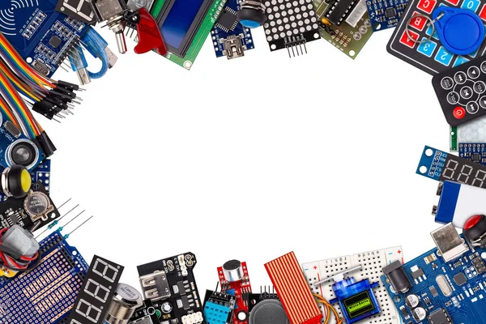
THE CYCLE OF LIFE
Add your words here
Add your words here
WE DESIRE TO MAKE OUR HOME BASED WORKS EASY AND CONVENIENT
FOOD
WORK
REST
REST
Add your words here
=
VACA
WORK
FOOD
Add your words here
WORK
Add your words here
REST
Add your words here
Add your words here

Slide 12
01
WHY VACA? ----- HOW VACA?
In the current hectic schedule, cleaning houses and surrounding environment is more arduous. At present, there are vacuum cleaners which require humans to handle it. Thus, there is a dire need to implement vacuum cleaner which works without human intervention. An efficient method to clean the desired area has been implemented through this project. By using this vacuum cleaner, hazardous places can be cleaned which thereby reduce risks to mankind. This is achieved by implementing an autonomous system. Here, RC car which is embedded with a vacuum cleaner is used. This system has an ultrasonic sensor attached to it, that helps in avoiding large obstacles such as tables, chairs, walls etc. By measuring the distance via this sensor, the car takes the direction where the distance between obstacle and car is more, hence avoiding the collision with the obstacles. The vacuum cleaner is designed with a CPU fan and a pipe is attached to the mouth of the bottle. The entire system is run by batteries.

Slide 13
APPLICATIONS
HOUSE AUTOMATION
PLASTIC & RUBBER PRODUCTION
SMALL SCALE INDUSTRIAL CLEANING
PHARMA & MEDS
MANUFACTURING UNIT
HOSPITALS

Slide 14
FUTURE ADVANCEMENTS:
-IN NANO-SIZE
-SENSING BIO AND NON-BIODEGRADABLE DOMESTIC WASTE AND SEGREGATING IN SEPERATE STORAGE UNIT.
-SUCTION AS WELL AS EJECTION
Add your words here
Add your words here
Add your words here
Add your words here
Add your words here

Slide 15
2028
A global survey of over 30,000 people shows that 46 per cent of Indians have significantly increased their frequency of cleaning households, and 2 in 3 people clean 5-7 times a week,
2020
MARKET RESEARCH
The global home automation market size was USD 64.58 billion in 2020. The market is projected to grow from USD 73.30 billion in 2022 to USD 163.24 billion in 2028 at a CAGR of 12.3% during the 2021-28 period. Based on market analysis , tge global market exhibited a significant growth of 11.9% in 2020 compared to the average year-on-year growth during 2017-2019.
ESTIMATION

Slide 16
PROJECT CAPITAL ,INVENTORY AND PRODUCTION COST
CAPITAL: 4k INR
INVENTORY COST: 2500-3000 INR/24.20-29.20 USD
PRODUCTION COST: 2000-2500 INR/24.20-25.15 USD
REVENUE EST- 2M (yearly)
YOU CAN ADD YOUR WEBSITE

Slide 17
VACA
THANKS
SMART VACCUM CLEANER

